Slide 1
Community Safety Action Strategy
Community’s Police Advisory Committee
April 8, 2024
Office of Strategy

Slide 2
Overview
Welcome
Overview Community Safety Action Strategy
Discussion
City and Dept Role in Community Safety
Gaps and Opportunities
Notes:
Chelsea

Slide 3
What is the Community Safety Action Strategy?
Community vision
Coordinated organizational strategy
Addresses perceptions of safety: Broader than policing and crime
Residents experience safety differently:
Collaborative effort to improve racial justice and equity
Notes:
Jacques

Slide 4
Co-create Healthy PLACES and Neighborhoods
Invest in PEOPLE and Prevention
RESPOND Effectively and with Care
Promote Healing and REPAIR
Notes:
Jacques

Slide 5
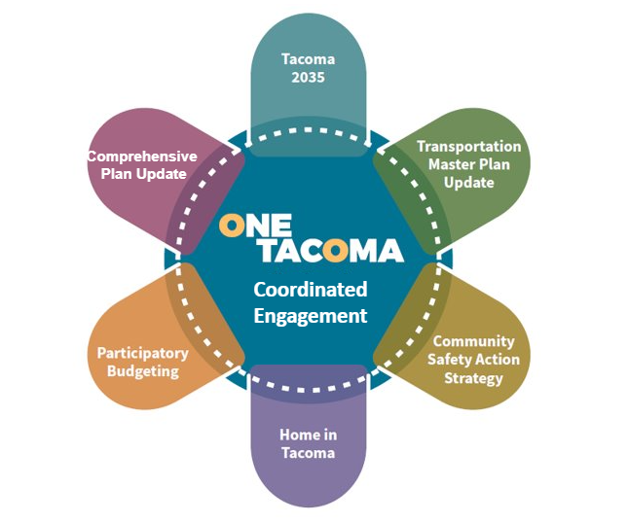
Coordinated Engagement
Communications
Website, Social Pinpoint, Social Media, Mailers
Community Survey
Road Show
Neighborhood Councils
Boards and Commissions
Community Organizations
Interviews
Lived Experts
Key Stakeholders
Visioning Workshops
Activities to help community members share vision for the future
Art focused
People centered
Language inclusivity

Slide 6
2024 Next Steps
Q1
Q2
Q3
Q4
Milestones | Q3 2023 | Q4 2023 | Q1 2024 | Q2 2024
Communications | Launch website and message approach | Reflect feedback to community and depts | Engage on final draft | Present Action Strategy
Engagement & Feedback | Community engagement and dept outreach ramps up | Partner engagement continues | Input reflected in draft | Implementation coordination
Writing Document | Complete first draft | Finalize outline and draft sections | Final draft complete, published | Implementation update
Implementation | Plan funding and partnership model | Begin external collaborative implementation model | Continue internal implementation efforts | Report on implementation with partners
Communications
Engagement
Writing Document
Implementation
Notes:
Gabe

Slide 7
Co-create Healthy PLACES and Neighborhoods
Support economic and environmental conditions that make Tacoma feel safe for everyone to live, learn, work and play
Action 1.1 Promote safe, inclusive, and people-centered city-infrastructure, maintenance, and utilities. Action 1.2 Improve access to safe, vibrant gathering places. Action 1.3: Increase access to safe and affordable transportation. Action 1.4: Support neighborhood businesses and safe business districts. Action 1.5: Increase livable wage job opportunities. Action 1.6 Increase the availability of stable, affordable housing. Action 1.7: Help create a pollution-free environment to mitigate climate change. Action 1.8: Improve access to safe and healthy food.
Notes:
Gabe

Slide 8
Invest in PEOPLE and prevention
Support focused approaches to specific community needs to create a sense of safety and belonging
Youth and Young Adults
Residents Experiencing Homelessness
Residents experiencing Mental and Behavioral Health (Including Substance Abuse Disorders)
Residents experiencing Domestic Violence
Residents with experience in the criminal justice system
Residents impacted by traffic violence and transportation disparities
Businesses
Neighborhood-specific Approaches
Notes:
Gabe

Slide 9
RESPOND Effectively and with Care
Act with respect and understanding to address community safety needs
Action 3.1: Enhance Immediate Incident response. Action 3.1: Provide Immediate Incident Response
Action 3.2: Coordinate the ability to effectively manage future emergencies
Action 3.3: Use equity and data-driven approaches to allocate community safety resources and address service gaps
Action 3.4: Ensure the organizational health of response functions
Action 3.5: Facilitate transparency and accountability
Action 3.6: Promote alternatives to (traditional) commissioned public safety responses
Notes:
Gabe

Slide 10
Promote Healing and REPAIR
Support individuals, families, and neighborhoods to overcome trauma, rebuild relationships, and work towards a community where everyone belongs
Increase opportunities for diversion from Courts to Community
Increase opportunities for effectively facilitated Restorative Justice
Ensure safe, supportive, and effective Reintegration
Improve engagement and relationships between Police and Community
Increase trauma-informed post-incident response
Promote conflict resolution and mediation
Support healing and repair for first responders
Notes:
Gabe

Slide 11
Discussion Questions
What do you see as being most important to prioritize in this strategy?
What groups or organizations can you help connect with?
Is this moving in the right direction?
Next Steps
Share events and opportunities for engagement
Review of document
Anything else?

Slide 12
Gabe Moaalii gmoaalii@cityoftacoma.org Chelsea Talbert ctalbert@cityoftacoma.org

